Slide 1
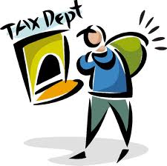
Sales Tax
Raw Data
 | State | Sales Tax
1 | Alabama | 4%
2 | Alaska | 0%
3 | Arizona | 6.60%
4 | Arkanas | 6%
5 | California | 6.25%
6 | Colorado | 2.90%
7 | Connecticut | 6.35%
8 | Delaware | 2.90%
9 | Florida | 6%
10 | Georgia | 4%
11 | Hawaii | 4%
12 | Idaho | 6%
13 | Illinois | 6.25%
14 | Indiana | 7%
15 | Iowa | 6%
16 | Kansas | 6.30%
17 | Kentucky | 6%
18 | Louisiana | 4%
19 | Maine | 5%
20 | Maryland | 6%
21 | Massachusetts | 6.25%
22 | Michigan | 6%
23 | Minnesota | 6.88%
24 | Mississippi | 7%
25 | Missouri | 4.23%
 | State | Sales Tax
26 | Montana | 0%
27 | Nebraska | 5.50%
28 | Nevada | 6.85%
29 | New Hampshire | 0%
30 | New Jersey | 7%
31 | New Mexico | 5.13%
32 | New York | 4%
33 | North Carolina | 4.75%
34 | North Dakota | 5%
35 | Ohio | 5.50%
36 | Oklahoma | 4.50%
37 | Oregon | 0%
38 | Pennsylvania | 6%
39 | Rhode Island | 7%
40 | South Carolina | 6%
41 | South Dakota | 4%
42 | Tennessee | 7%
43 | Texas | 6.25%
44 | Utah | 4.70%
45 | Vermont | 6%
46 | Virginia | 4%
47 | Washington | 6.50%
48 | West Virginia | 6%
49 | Wisconsin | 5%
50 | Wyoming | 4%

Slide 2
Sales Tax
Data Table
 | Tax | Frequency | Cumulative Freq. | Relative Freq. | Rel. Cumulative Freq.
1 | 0% | 4 | 4 | 8% | 8%
2 | 2.90% | 2 | 6 | 4% | 12%
3 | 4% | 8 | 14 | 16% | 28%
4 | 4.23% | 1 | 15 | 2% | 30%
5 | 4.50% | 1 | 16 | 2% | 32%
6 | 4.70% | 1 | 17 | 2% | 34%
7 | 4.75% | 1 | 18 | 2% | 36%
8 | 5% | 3 | 21 | 6% | 42%
9 | 5.13% | 1 | 22 | 2% | 44%
10 | 5.50% | 2 | 24 | 4% | 48%
11 | 6% | 11 | 35 | 22% | 70%
12 | 6.25% | 4 | 39 | 8% | 78%
13 | 6.30% | 1 | 40 | 2% | 80%
14 | 6.35% | 1 | 41 | 2% | 82%
15 | 6.50% | 1 | 42 | 2% | 84%
16 | 6.60% | 1 | 43 | 2% | 86%
17 | 6.85% | 1 | 44 | 2% | 88%
18 | 6.88% | 1 | 45 | 2% | 90%
19 | 7% | 5 | 50 | 10% | 100%

Slide 3
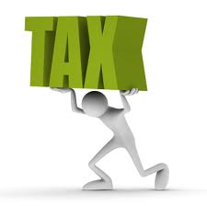
Histogram
Frequency
0.00%
4.00%
4.75%
5.13%
4.23%
4.50%
4.70%
5.00%
5.5%
2.90%
6.00%
6.25%
6.30%
6.35%
6.50%
6.60%
7.00%
6.85%
Sale Tax (Percent)
6.88%

Slide 4
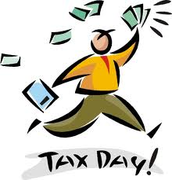
Box and Whisker Plot
0%
7%
4%
6%
6.25%
Outliers
6.25 – 4 = 2.25
2.25 (1.5) = 3.375
4 – 3.375 = .625 or lower
6.25 + 3.375 = 9.625 or above
0 is and outlier
Five Number Summary
Median: 6%
LE: 0%
UE: 7%
LQ: 4%
UQ: 6.25%

Slide 5
Summary
I chose this topic because I thought it would be interesting to learn more about.
I found it interesting that the most common tax was 6% and that there are four states that don’t have sales tax at all.
I thought that the most challenging part of this project was making the histogram.
If I could change something, I would change the y axis on my histogram.

Slide 6
Source Page
Sales Tax Institute
http://www.salestaxinstitute.com/State_Sales_Tax_Rates - (4/27/12)

